Slide 1
Conway's Game of Life
Saivivek Therala
Thirupathi Gandla

Slide 2
Intro
1. Pattern Grids
2. Random Population

Slide 3
Patterns
Buttons:
1.Start game
2.STOP GAME
3.Increment 1 generation
4.Increment 23 generations
5.RESET

Slide 4
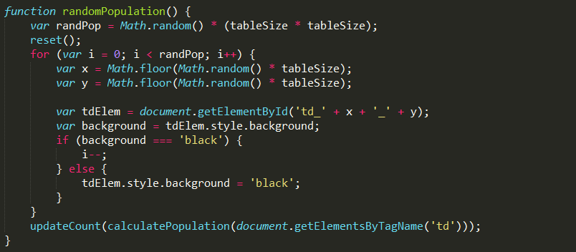
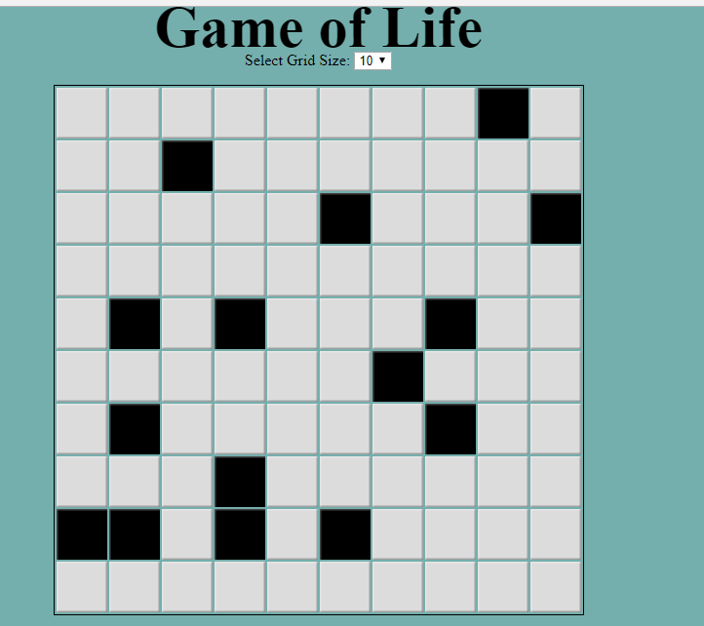
Code snippet for random population

Slide 5
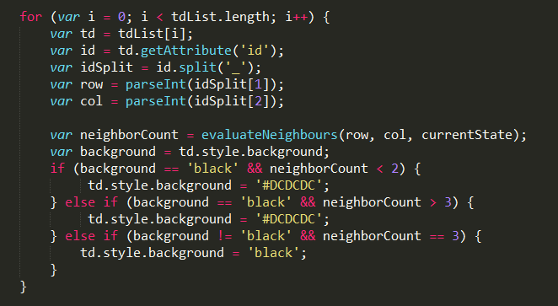
Core logic of game

Slide 6
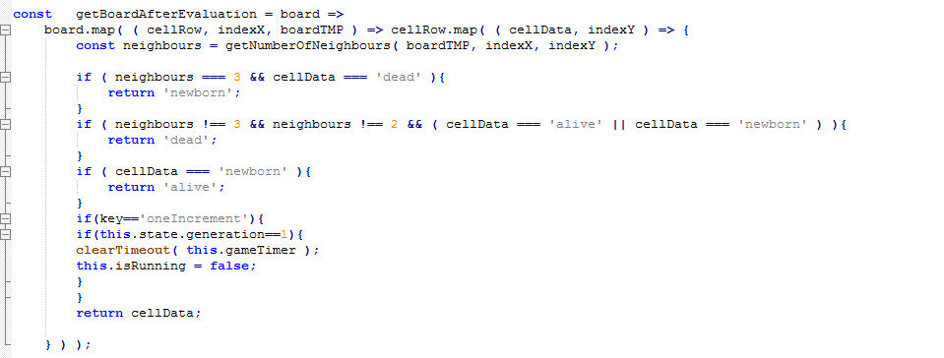
Code snippet

Slide 7
DEMO

